Slide 1
CSDS 451: Designing High Performant Systems for AI
Lecture 11
9/30/2025
Sanmukh Kuppannagari
sanmukh.kuppannagari@case.edu
https://sanmukh.research.st/
Case Western Reserve University

Slide 2
Outline
Sparsity in Convolutions

Slide 3
Announcements
WA 2 due by Friday
PA 1 will be out by Saturday Morning
Midterm next Thursday - 10/9
Will discuss logistics and other details in the next lecture
Will include topics till today’s lecture

Slide 4
Project
Two Types of Project
Type #1 (HIP based):
Take a CNN based Machine Learning Model
Calculate the inference time of the model using pytorch
Implement each convolution layer using one of the convolution algorithm discussed in class using HIP
Convert the layer in correct matrix dimensions
Use your PA1 implementation of blocked matrix multiplication and gemm based matrix multiplication
Compare the inference times of pytorch, blocked mm with best parallelism parameter, and gemm based MM
Optional (for teams of size 3): we can discuss some addons, compare CO2 emissions of all three techniques, compare performance between different convolution algorithms, choose best convolution algorithm for each layer and then compare performance

Slide 5
Project
Type #2
Take a LLM based machine learning model
Use pytorch lightning for distributed training and calculate time (baseline)
Using mpi4python, implement your own distributed training framework and compare performance
Optional (for teams of size 3): Use your HIP MM codes for implementing the matrix multiplication of the LLM

Slide 6
Project
Not expecting an end to end framework that takes any model and performs the deployment.
You can have code that calculates the times for each layer separately and sums them up
Functional correctness is secondary, but there shouldn’t be obvious flaws.

Slide 7
Project
Not expecting your implementation will definitely beat the performance of pytorch or pytorch-lightning
(It is definitely possible, my research student has implementations that perform 2-3x better than pytorch)
Taking risks and failing will not be penalized
As long as you can show reasonable effort was put into the project

Slide 8
Project Deliverables
1 page project proposal (5 points)
Objective:
Approach:
Baselines for Comparison:
Metrics used for Comparison:
Definition of Success:
Send me after having a 1-1 meeting with me

Slide 9
Project Deliverables
Demonstration of the Project (10 points), includes
Code + data submission
Instructions and comments so that TA can reproduce the results
in-person or online walkthrough of the results
Project Report (5 points)
2 pages (can be larger too)
Expand the approach section of the project proposal with actual implementation details and challenges that you faces
Add an Experimental Results section to the project proposal that
Discusses your findings
Your thoughts or comments about any patterns you saw in the finding (most critical – simply saying algorithm A performs better than algorithm B in all cases is not a very thoughtful comment. Tell us why you think that is the case)

Slide 10
Project – Next Action
Team information due by 10/16
I will upload an assignment for this
Preferred Team size – 2 students per team
3 or 1 will be allowed only if you make a strong case for it

Slide 11
Outline
Sparsity in Convolutions

Slide 12
Reading Materials
Cheng, Hongrong, Miao Zhang, and Javen Qinfeng Shi. "A survey on deep neural network pruning: Taxonomy, comparison, analysis, and recommendations." IEEE Transactions on Pattern Analysis and Machine Intelligence (2024).

Slide 13
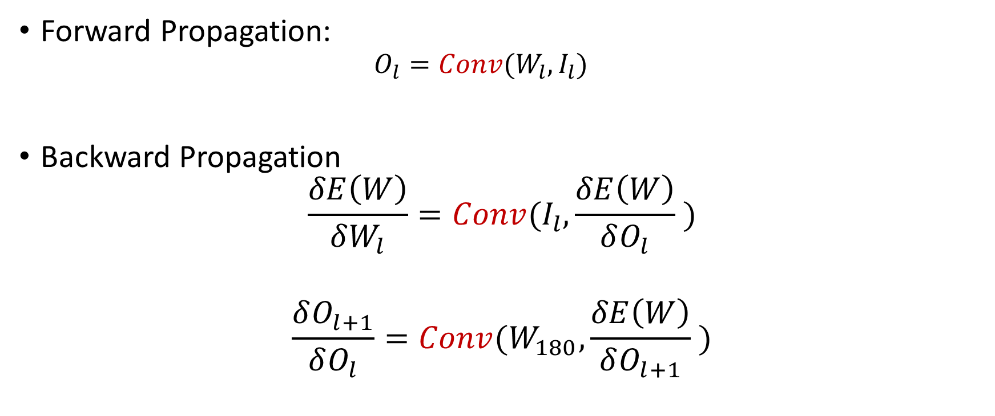
Key Operation in CNN
Forward Propagation:
$$O_{l}=Conv(W_{l}, I_{l})$$
Backward Propagation
$$\frac{δE\left(W\right)}{δW_{l}}=Conv(I_{l},\frac{δE\left(W\right)}{δO_{l}} )$$
$$\frac{δO_{l+1}}{δO_{l}}=Conv(W_{180},\frac{δE\left(W\right)}{δO_{l+1}} )$$

Slide 14
CNN on A100 Roofline Plot (assuming infinite cache)
Memory Bound
Compute Bound
Peak
Performance
Sustained Performance
(ops/sec)
75
Arithmetic Intensity
Which area will the CNN Performance lie in? Compute Bound

Slide 15
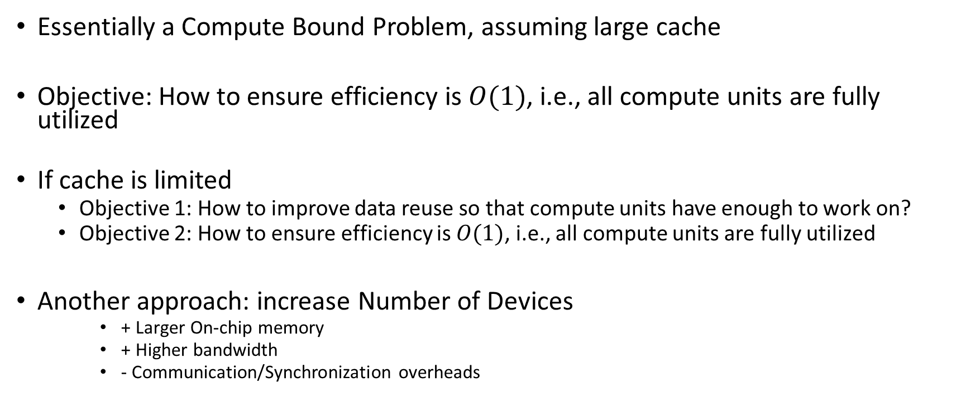
Implications
Essentially a Compute Bound Problem, assuming large cache
Objective: How to ensure efficiency is $O(1)$, i.e., all compute units are fully utilized
If cache is limited
Objective 1: How to improve data reuse so that compute units have enough to work on?
Objective 2: How to ensure efficiency is $O(1)$, i.e., all compute units are fully utilized
Another approach: increase Number of Devices
+ Larger On-chip memory
+ Higher bandwidth
- Communication/Synchronization overheads

Slide 16
Convolution as Matrix Multiplications
Transform the input features and kernels into matrices and perform matrix multiplication.
Theoretically, matrix multiplication algorithms achieve cost optimality and good data reuse
Practically, every hardware vendor provides optimized implementations of matrix operations

Slide 17
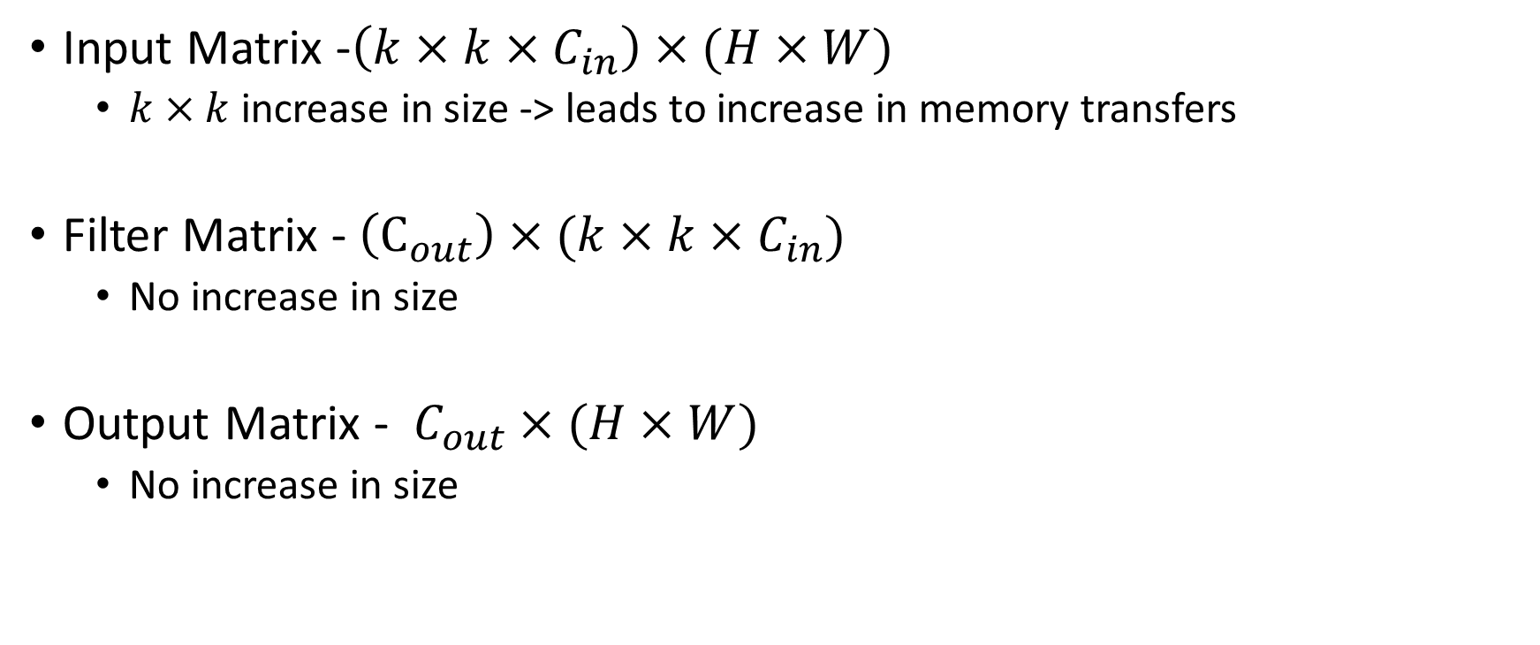
Im2Col Algorithm
Input Matrix -$\left(k×k×C_{in}\right)×(H×W)$
$k×k$ increase in size -> leads to increase in memory transfers
Filter Matrix - $\left(C_{out}\right)×(k×k×C_{in})$
No increase in size
Output Matrix - $C_{out}×(H×W)$
No increase in size

Slide 18
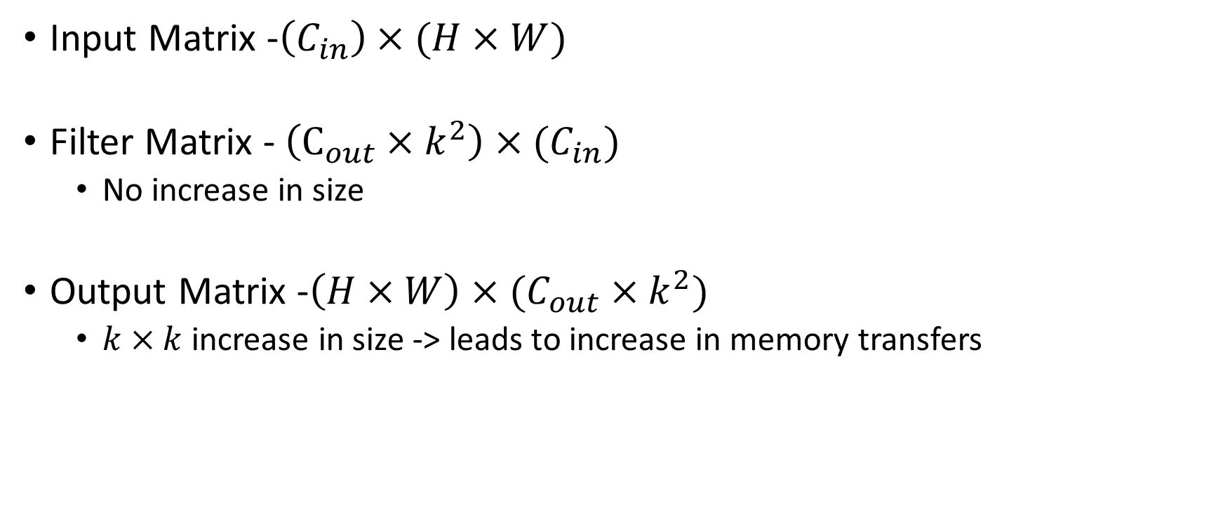
Kn2Row Algorithm
Input Matrix -$\left(C_{in}\right)×(H×W)$
Filter Matrix - $\left(C_{out}×k^{2}\right)×(C_{in})$
No increase in size
Output Matrix -$\left(H×W\right)×(C_{out}×k^{2})$
$k×k$ increase in size -> leads to increase in memory transfers

Slide 19
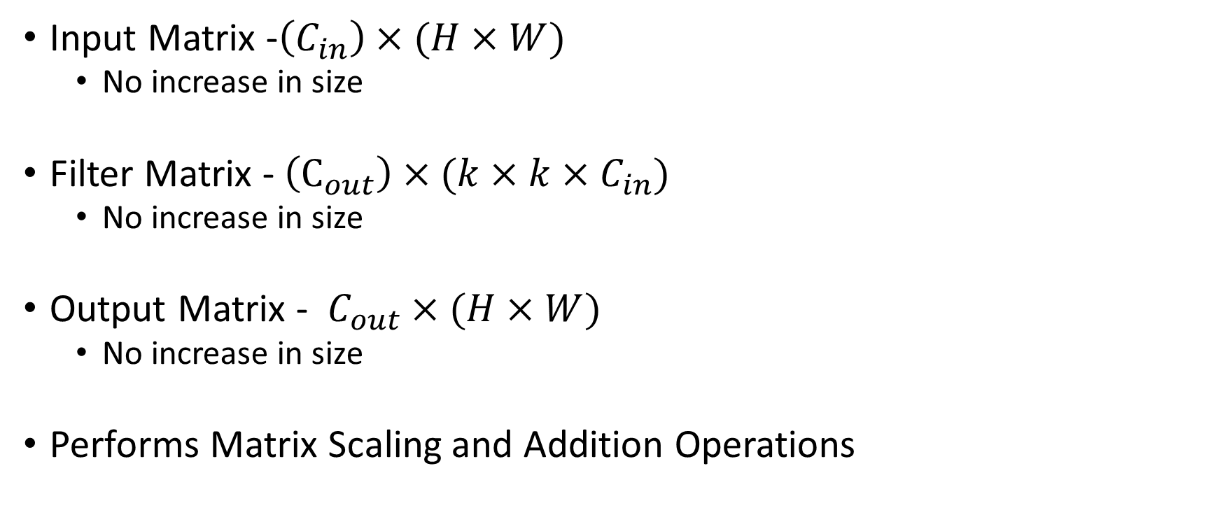
Scalar Matrix Multiplication
Input Matrix -$\left(C_{in}\right)×(H×W)$
No increase in size
Filter Matrix - $\left(C_{out}\right)×(k×k×C_{in})$
No increase in size
Output Matrix - $C_{out}×(H×W)$
No increase in size
Performs Matrix Scaling and Addition Operations

Slide 20
Sparsity in Convolution
Algorithms discussed till now do not change CNN models
Functionally Correct
No change in the number of operations performed
Sparsity: An orthogonal research direction is to reduce the number of operations performed and memory transferred in the CNN, while ensuring accuracy loss is not too high

Slide 21
Introducing Sparsity
Two main techniques
#1: Remove some weights of the kernels - pruning
#2: Reduce the size of data type used to represent weights of the kernels - quantization

Slide 22
Pruning
Two types:
Unstructured Pruning: Remove weights randomly (or using some rules) without considering the impact on hardware execution
Structured Pruning: Remove weights in a structured manner, so that
Non-zero elements are packed together, data transfers utilize maximum bandwidth due to sequential access

Slide 23
Unstructured Pruning
Remove weights randomly (or using some rules) without considering the impact on hardware execution
Consider Im2col based convolution
Inputs
Kernel

Slide 24
Unstructured Pruning
Remove weights randomly (or using some rules) without considering the impact on hardware execution
Consider Im2col based convolution
Inputs
Kernel

Slide 25
Unstructured Pruning - Approaches
Magnitude based pruning
Example: In a trained model, keep only top-k percentage of weights in terms of magnitude or norm
Can also be done iteratively: Train a model, remove x% of weights, fine-tune the model, remove another x% and so on.
Gradient based pruning
Removes weights whose gradients with respect to the error function is lower
Refer to the survey paper for a thorough discussion on various pruning techniques.
We are simply interested in how to efficiently run a pruned model in this class

Slide 26
Unstructured Pruning
Consider Im2Col based Convolution
Inputs
Kernel

Slide 27
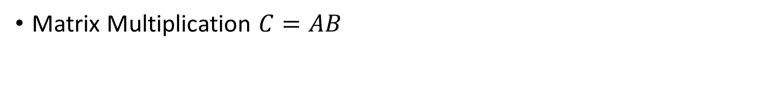
Unstructured Pruning
Matrix Multiplication $C=AB$
Sparse Matrix
Dense Matrix
Inputs
Kernel

Slide 28
Sparse Dense Matrix Multiplication (SpMM)
An important kernel in Scientific Computing as well as Machine Learning applications
Extensive Research has been performed (and still continuing) on accelerating SpMM
Key Challenge: Cannot use dense-dense matrix multiplication techniques
Inefficient Storage
Non-useful computations
Optimizations
Efficient Storage of Sparse Matrices
Work optimal task scheduling
We will discuss SpMM acceleration in Transformer lectures.

Slide 29
Unstructured Pruning
Consider Im2Col based Convolution
Inputs
Kernel

Slide 30
Unstructured Pruning
Consider Im2Col based Convolution
Highlighted elements of Input need to be contiguous
Inputs
Kernel

Slide 31
Unstructured Pruning
Consider Im2Col based Convolution
Highlighted elements of Input need to be contiguous why??
Inputs
Kernel

Slide 32
Unstructured Pruning
Consider Im2Col based Convolution
Highlighted elements of Input need to be contiguous
Sequential layout leads to bandwidth maximization and latency reduction
Inputs
Kernel

Slide 33
Unstructured Pruning
Consider Im2Col based Convolution
Highlighted elements of Input need to be contiguous
No single sequential storage of Inputs works for both rows of the kernel
Inputs
Kernel

Slide 34
Structured Pruning
Consider Im2Col based Convolution
Inputs
Kernel

Slide 35
Structured Pruning
Consider Im2Col based Convolution
Highlighted elements of Input need to be contiguous
Inputs
Kernel

Slide 36
Structured Pruning
Consider Im2Col based Convolution
Highlighted elements of Input need to be contiguous
Same sequential storage of Inputs works for both rows of the kernel
Inputs
Kernel

Slide 37
Structured Pruning
Objective is to achieve structure in pruning that makes it hardware friendly
For example, by ensuring same sequential storage of inputs work for all channels in the previous example
Examples of “structures” that can be pruned
Entire Channels
Entire Filters
Entire Layers

Slide 38




























































































Structured Pruning – Output Channel Pruning
$$I_{1}$$
$$I_{2}$$
$$I_{3}$$
$$I_{2}$$
$$I_{3}$$
$$I_{4}$$
$$I_{1}$$
$$I_{2}$$
$$I_{3}$$
$$I_{4}$$
$$I_{1}$$
$$I_{2}$$
$$I_{3}$$
$$I_{4}$$
$$I_{5}$$
$$I_{6}$$
$$I_{7}$$
$$I_{5}$$
$$I_{6}$$
$$I_{7}$$
$$I_{8}$$
$$I_{5}$$
$$I_{6}$$
$$I_{7}$$
$$I_{8}$$
$$I_{6}$$
$$I_{7}$$
$$I_{8}$$
$$k×k×C_{in}$$
$$I_{9}$$
$$I_{10}$$
$$I_{11}$$
$$I_{12}$$
$$I_{9}$$
$$I_{10}$$
$$I_{11}$$
$$I_{12}$$
$$I_{1}$$
$$I_{2}$$
$$I_{3}$$
$$I_{13}$$
$$I_{14}$$
$$I_{15}$$
$$I_{16}$$
$$I_{13}$$
$$I_{14}$$
$$I_{15}$$
$$I_{16}$$
$$I_{2}$$
$$I_{3}$$
$$I_{4}$$
$$I_{5}$$
$$I_{6}$$
$$I_{7}$$
$$k×k×C_{in}$$
$$I_{6}$$
$$I_{7}$$
$$I_{8}$$
$$W_{1}$$
$$W_{2}$$
$$W_{1}$$
$$W_{2}$$
$$H×W$$
$$W_{1}$$
$$W_{2}$$
$$W_{3}$$
$$W_{4}$$
$$W_{1}$$
$$W_{2}$$
$$W_{3}$$
$$W_{4}$$
$$W_{3}$$
$$W_{4}$$
$$W_{3}$$
$$W_{4}$$
$$C_{out}$$
$$W_{1}$$
$$W_{2}$$
$$W_{1}$$
$$W_{2}$$
$$W_{1}$$
$$W_{2}$$
$$W_{3}$$
$$W_{4}$$
$$W_{1}$$
$$W_{2}$$
$$W_{3}$$
$$W_{4}$$
$$W_{3}$$
$$W_{4}$$
$$W_{3}$$
$$W_{4}$$

Slide 39
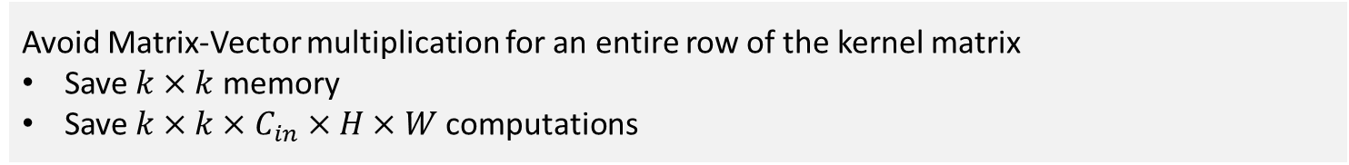
Structured Pruning – Output Channel Pruning
$$I_{1}$$
$$I_{2}$$
$$I_{3}$$
$$I_{2}$$
$$I_{3}$$
$$I_{4}$$
$$I_{1}$$
$$I_{2}$$
$$I_{3}$$
$$I_{4}$$
$$I_{1}$$
$$I_{2}$$
$$I_{3}$$
$$I_{4}$$
$$I_{5}$$
$$I_{6}$$
$$I_{7}$$
$$I_{5}$$
$$I_{6}$$
$$I_{7}$$
$$I_{8}$$
$$I_{5}$$
$$I_{6}$$
$$I_{7}$$
$$I_{8}$$
$$I_{6}$$
$$I_{7}$$
$$I_{8}$$
$$k×k×C_{in}$$
$$I_{9}$$
$$I_{10}$$
$$I_{11}$$
$$I_{12}$$
$$I_{9}$$
$$I_{10}$$
$$I_{11}$$
$$I_{12}$$
$$I_{1}$$
$$I_{2}$$
$$I_{3}$$
$$I_{13}$$
$$I_{14}$$
$$I_{15}$$
$$I_{16}$$
$$I_{13}$$
$$I_{14}$$
$$I_{15}$$
$$I_{16}$$
$$I_{2}$$
$$I_{3}$$
$$I_{4}$$
$$I_{5}$$
$$I_{6}$$
$$I_{7}$$
$$k×k×C_{in}$$
$$I_{6}$$
$$I_{7}$$
$$I_{8}$$
$$W_{1}$$
$$W_{2}$$
$$W_{1}$$
$$W_{2}$$
$$H×W$$
$$W_{1}$$
$$W_{2}$$
$$W_{3}$$
$$W_{4}$$
$$W_{1}$$
$$W_{2}$$
$$W_{3}$$
$$W_{4}$$
$$W_{3}$$
$$W_{4}$$
$$W_{3}$$
$$W_{4}$$
Avoid Matrix-Vector multiplication for an entire row of the kernel matrix
Save $k×k$ memory
Save $k×k×C_{in}×H×W$ computations
$$C_{out}$$
$$W_{1}$$
$$W_{2}$$
$$W_{1}$$
$$W_{2}$$
$$W_{1}$$
$$W_{2}$$
$$W_{3}$$
$$W_{4}$$
$$W_{1}$$
$$W_{2}$$
$$W_{3}$$
$$W_{4}$$
$$W_{3}$$
$$W_{4}$$
$$W_{3}$$
$$W_{4}$$

Slide 40
Structured Pruning – Input Channel Pruning
$$I_{1}$$
$$I_{2}$$
$$I_{3}$$
$$I_{2}$$
$$I_{3}$$
$$I_{4}$$
$$I_{1}$$
$$I_{2}$$
$$I_{3}$$
$$I_{4}$$
$$I_{1}$$
$$I_{2}$$
$$I_{3}$$
$$I_{4}$$
$$I_{5}$$
$$I_{6}$$
$$I_{7}$$
$$I_{5}$$
$$I_{6}$$
$$I_{7}$$
$$I_{8}$$
$$I_{5}$$
$$I_{6}$$
$$I_{7}$$
$$I_{8}$$
$$I_{6}$$
$$I_{7}$$
$$I_{8}$$
$$k×k×C_{in}$$
$$I_{9}$$
$$I_{10}$$
$$I_{11}$$
$$I_{12}$$
$$I_{9}$$
$$I_{10}$$
$$I_{11}$$
$$I_{12}$$
$$I_{1}$$
$$I_{2}$$
$$I_{3}$$
$$I_{13}$$
$$I_{14}$$
$$I_{15}$$
$$I_{16}$$
$$I_{13}$$
$$I_{14}$$
$$I_{15}$$
$$I_{16}$$
$$I_{2}$$
$$I_{3}$$
$$I_{4}$$
$$I_{5}$$
$$I_{6}$$
$$I_{7}$$
$$k×k×C_{in}$$
$$I_{6}$$
$$I_{7}$$
$$I_{8}$$
$$W_{1}$$
$$W_{2}$$
$$W_{1}$$
$$W_{2}$$
$$H×W$$
$$W_{1}$$
$$W_{2}$$
$$W_{3}$$
$$W_{4}$$
$$W_{1}$$
$$W_{2}$$
$$W_{3}$$
$$W_{4}$$
$$W_{3}$$
$$W_{4}$$
$$W_{3}$$
$$W_{4}$$
$$C_{out}$$
$$W_{1}$$
$$W_{2}$$
$$W_{1}$$
$$W_{2}$$
$$W_{1}$$
$$W_{2}$$
$$W_{3}$$
$$W_{4}$$
$$W_{1}$$
$$W_{2}$$
$$W_{3}$$
$$W_{4}$$
$$W_{3}$$
$$W_{4}$$
$$W_{3}$$
$$W_{4}$$

Slide 41

Structured Pruning – Input Channel Pruning
$$I_{1}$$
$$I_{2}$$
$$I_{3}$$
$$I_{2}$$
$$I_{3}$$
$$I_{4}$$
Avoid Matrix-Matrix Multiplication for a smaller block
Save $k×k×{(C}_{out}+HW)$ memory
Save $C_{out}HWk^{2}$ computations
$$I_{1}$$
$$I_{2}$$
$$I_{3}$$
$$I_{4}$$
$$I_{1}$$
$$I_{2}$$
$$I_{3}$$
$$I_{4}$$
$$I_{5}$$
$$I_{6}$$
$$I_{7}$$
$$I_{5}$$
$$I_{6}$$
$$I_{7}$$
$$I_{8}$$
$$I_{5}$$
$$I_{6}$$
$$I_{7}$$
$$I_{8}$$
$$I_{6}$$
$$I_{7}$$
$$I_{8}$$
$$k×k×C_{in}$$
$$I_{9}$$
$$I_{10}$$
$$I_{11}$$
$$I_{12}$$
$$I_{9}$$
$$I_{10}$$
$$I_{11}$$
$$I_{12}$$
$$I_{1}$$
$$I_{2}$$
$$I_{3}$$
$$I_{13}$$
$$I_{14}$$
$$I_{15}$$
$$I_{16}$$
$$I_{13}$$
$$I_{14}$$
$$I_{15}$$
$$I_{16}$$
$$I_{2}$$
$$I_{3}$$
$$I_{4}$$
$$I_{5}$$
$$I_{6}$$
$$I_{7}$$
$$k×k×C_{in}$$
$$I_{6}$$
$$I_{7}$$
$$I_{8}$$
$$W_{1}$$
$$W_{2}$$
$$W_{1}$$
$$W_{2}$$
$$H×W$$
$$W_{1}$$
$$W_{2}$$
$$W_{3}$$
$$W_{4}$$
$$W_{1}$$
$$W_{2}$$
$$W_{3}$$
$$W_{4}$$
$$W_{3}$$
$$W_{4}$$
$$W_{3}$$
$$W_{4}$$
$$C_{out}$$
$$W_{1}$$
$$W_{2}$$
$$W_{1}$$
$$W_{2}$$
$$W_{1}$$
$$W_{2}$$
$$W_{3}$$
$$W_{4}$$
$$W_{1}$$
$$W_{2}$$
$$W_{3}$$
$$W_{4}$$
$$W_{3}$$
$$W_{4}$$
$$W_{3}$$
$$W_{4}$$

Slide 42
Structured Pruning – Filter/Connection Pruning
$$I_{1}$$
$$I_{2}$$
$$I_{3}$$
$$I_{2}$$
$$I_{3}$$
$$I_{4}$$
$$I_{1}$$
$$I_{2}$$
$$I_{3}$$
$$I_{4}$$
$$I_{1}$$
$$I_{2}$$
$$I_{3}$$
$$I_{4}$$
$$I_{5}$$
$$I_{6}$$
$$I_{7}$$
$$I_{5}$$
$$I_{6}$$
$$I_{7}$$
$$I_{8}$$
$$I_{5}$$
$$I_{6}$$
$$I_{7}$$
$$I_{8}$$
$$I_{6}$$
$$I_{7}$$
$$I_{8}$$
$$k×k×C_{in}$$
$$I_{9}$$
$$I_{10}$$
$$I_{11}$$
$$I_{12}$$
$$I_{9}$$
$$I_{10}$$
$$I_{11}$$
$$I_{12}$$
$$I_{1}$$
$$I_{2}$$
$$I_{3}$$
$$I_{13}$$
$$I_{14}$$
$$I_{15}$$
$$I_{16}$$
$$I_{13}$$
$$I_{14}$$
$$I_{15}$$
$$I_{16}$$
$$I_{2}$$
$$I_{3}$$
$$I_{4}$$
$$I_{5}$$
$$I_{6}$$
$$I_{7}$$
$$k×k×C_{in}$$
$$I_{6}$$
$$I_{7}$$
$$I_{8}$$
$$W_{1}$$
$$W_{2}$$
$$W_{1}$$
$$W_{2}$$
$$H×W$$
$$W_{1}$$
$$W_{2}$$
$$W_{3}$$
$$W_{4}$$
$$W_{1}$$
$$W_{2}$$
$$W_{3}$$
$$W_{4}$$
$$W_{3}$$
$$W_{4}$$
$$W_{3}$$
$$W_{4}$$
$$C_{out}$$
$$W_{1}$$
$$W_{2}$$
$$W_{1}$$
$$W_{2}$$
$$W_{1}$$
$$W_{2}$$
$$W_{3}$$
$$W_{4}$$
$$W_{1}$$
$$W_{2}$$
$$W_{3}$$
$$W_{4}$$
$$W_{3}$$
$$W_{4}$$
$$W_{3}$$
$$W_{4}$$

Slide 43
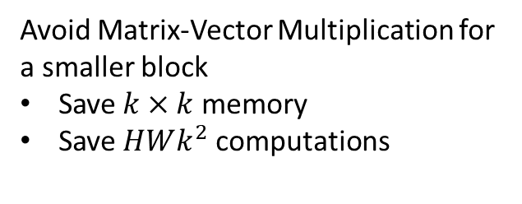
Structured Pruning – Filter/Connection Pruning
$$I_{1}$$
$$I_{2}$$
$$I_{3}$$
$$I_{2}$$
$$I_{3}$$
$$I_{4}$$
$$I_{1}$$
$$I_{2}$$
$$I_{3}$$
$$I_{4}$$
$$I_{1}$$
$$I_{2}$$
$$I_{3}$$
$$I_{4}$$
$$I_{5}$$
$$I_{6}$$
$$I_{7}$$
$$I_{5}$$
$$I_{6}$$
$$I_{7}$$
$$I_{8}$$
$$I_{5}$$
$$I_{6}$$
$$I_{7}$$
$$I_{8}$$
$$I_{6}$$
$$I_{7}$$
$$I_{8}$$
$$k×k×C_{in}$$
$$I_{9}$$
$$I_{10}$$
$$I_{11}$$
$$I_{12}$$
$$I_{9}$$
$$I_{10}$$
$$I_{11}$$
$$I_{12}$$
Avoid Matrix-Vector Multiplication for a smaller block
Save $k×k$ memory
Save $HWk^{2}$ computations
$$I_{1}$$
$$I_{2}$$
$$I_{3}$$
$$I_{13}$$
$$I_{14}$$
$$I_{15}$$
$$I_{16}$$
$$I_{13}$$
$$I_{14}$$
$$I_{15}$$
$$I_{16}$$
$$I_{2}$$
$$I_{3}$$
$$I_{4}$$
$$I_{5}$$
$$I_{6}$$
$$I_{7}$$
$$k×k×C_{in}$$
$$I_{6}$$
$$I_{7}$$
$$I_{8}$$
$$W_{1}$$
$$W_{2}$$
$$W_{1}$$
$$W_{2}$$
$$H×W$$
$$W_{1}$$
$$W_{2}$$
$$W_{3}$$
$$W_{4}$$
$$W_{1}$$
$$W_{2}$$
$$W_{3}$$
$$W_{4}$$
$$W_{3}$$
$$W_{4}$$
$$W_{3}$$
$$W_{4}$$
$$C_{out}$$
$$W_{1}$$
$$W_{2}$$
$$W_{1}$$
$$W_{2}$$
$$W_{1}$$
$$W_{2}$$
$$W_{3}$$
$$W_{4}$$
$$W_{1}$$
$$W_{2}$$
$$W_{3}$$
$$W_{4}$$
$$W_{3}$$
$$W_{4}$$
$$W_{3}$$
$$W_{4}$$

Slide 44
Structured Pruning – Layer Pruning
$$I_{1}$$
$$I_{2}$$
$$I_{3}$$
$$I_{2}$$
$$I_{3}$$
$$I_{4}$$
$$I_{1}$$
$$I_{2}$$
$$I_{3}$$
$$I_{4}$$
$$I_{1}$$
$$I_{2}$$
$$I_{3}$$
$$I_{4}$$
$$I_{5}$$
$$I_{6}$$
$$I_{7}$$
$$I_{5}$$
$$I_{6}$$
$$I_{7}$$
$$I_{8}$$
$$I_{5}$$
$$I_{6}$$
$$I_{7}$$
$$I_{8}$$
$$I_{6}$$
$$I_{7}$$
$$I_{8}$$
$$k×k×C_{in}$$
$$I_{9}$$
$$I_{10}$$
$$I_{11}$$
$$I_{12}$$
$$I_{9}$$
$$I_{10}$$
$$I_{11}$$
$$I_{12}$$
$$I_{1}$$
$$I_{2}$$
$$I_{3}$$
$$I_{13}$$
$$I_{14}$$
$$I_{15}$$
$$I_{16}$$
$$I_{13}$$
$$I_{14}$$
$$I_{15}$$
$$I_{16}$$
$$I_{2}$$
$$I_{3}$$
$$I_{4}$$
$$I_{5}$$
$$I_{6}$$
$$I_{7}$$
$$k×k×C_{in}$$
$$I_{6}$$
$$I_{7}$$
$$I_{8}$$
$$W_{1}$$
$$W_{2}$$
$$W_{1}$$
$$W_{2}$$
$$H×W$$
$$W_{1}$$
$$W_{2}$$
$$W_{3}$$
$$W_{4}$$
$$W_{1}$$
$$W_{2}$$
$$W_{3}$$
$$W_{4}$$
$$W_{3}$$
$$W_{4}$$
$$W_{3}$$
$$W_{4}$$
$$C_{out}$$
$$W_{1}$$
$$W_{2}$$
$$W_{1}$$
$$W_{2}$$
$$W_{1}$$
$$W_{2}$$
$$W_{3}$$
$$W_{4}$$
$$W_{1}$$
$$W_{2}$$
$$W_{3}$$
$$W_{4}$$
$$W_{3}$$
$$W_{4}$$
$$W_{3}$$
$$W_{4}$$

Slide 45
Structured Pruning – Layer Pruning

Slide 46
Structured Pruning
Pruning entire layers or channels lead to significant reduction in memory and computation
But may lead to significant accuracy drop
Pruning filters/connections lets you prune at a finer granularity level (compared to layers or channels) and may preserve accuracy
In practice, the best pruning technique entirely depends upon the application domain

Slide 47













Grouped Convolutions
A type of Filter/Connection pruning
$$C_{in}$$
$$0$$
$$1$$
$$W_{1}$$
$$W_{2}$$
$$W_{3}$$
$$W_{4}$$
$$W_{1}$$
$$W_{2}$$
$$W_{3}$$
$$W_{4}$$
$$C_{out}$$
$$0$$
$$C_{out}$$
$$=$$
$$1$$
$$W_{1}$$
$$W_{2}$$
$$W_{3}$$
$$W_{4}$$
$$W_{1}$$
$$W_{2}$$
$$W_{3}$$
$$W_{4}$$
Each cell here is an entire $k×k$ kernel
$$W_{1}$$
$$W_{2}$$
$$W_{3}$$
$$W_{4}$$
$$=$$

Slide 48
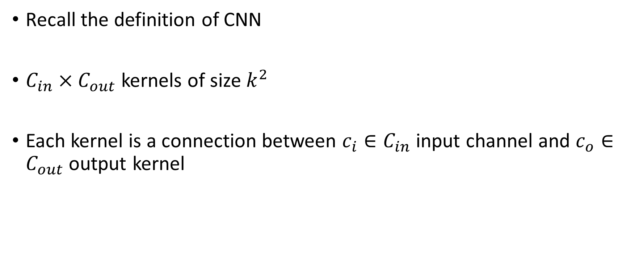
Grouped Convolutions
Recall the definition of CNN
$C_{in}×C_{out}$ kernels of size $k^{2}$
Each kernel is a connection between $c_{i}∈C_{in}$ input channel and $c_{o}∈C_{out}$ output kernel

Slide 49

Grouped Convolution
Key Idea: Remove a subset of $C_{in}×C_{out}$ connections by:
Partition $C_{in}$ input channels into $g$ groups
Partition $C_{out}$ output channels into $g$ groups
Only include connections between input and output channels when both belong to same group id $g_{id}∈g$

Slide 50






















Grouped Convolution
$$C_{in}$$
$$0$$
$$1$$
$$2$$
$$3$$
$$4$$
$$5$$
$$6$$
$$7$$
$$8$$
$$9$$
$$10$$
$$11$$
$$12$$
$$13$$
$$14$$
$$15$$
$$C_{out}$$
$$0$$
$$1$$
$$2$$
$$3$$
Note: Each cell here is an entire $k×k$ kernel
Kernel

Slide 51









Grouped Convolution
Partition $C_{in}$ input channels into $g$ groups
Partition $C_{out}$ output channels into $g$ groups
$$0$$
$$1$$
$$2$$
$$3$$
$$g=4$$
$$C_{in}$$
$$0$$
$$1$$
$$2$$
$$3$$
$$4$$
$$5$$
$$6$$
$$7$$
$$8$$
$$9$$
$$10$$
$$11$$
$$12$$
$$13$$
$$14$$
$$15$$
$$C_{out}$$
$$0$$
$$1$$
$$2$$
$$3$$
Note: Each cell here is an entire $k×k$ kernel
Kernel

Slide 52
Grouped Convolution
Only include connections between input and output channels when both belong to same group id $g_{id}∈g$
$$0$$
$$1$$
$$2$$
$$3$$
$$g=4$$
$$C_{in}$$
$$0$$
$$1$$
$$2$$
$$3$$
$$4$$
$$5$$
$$6$$
$$7$$
$$8$$
$$9$$
$$10$$
$$11$$
$$12$$
$$13$$
$$14$$
$$15$$
$$C_{out}$$
$$0$$
$$1$$
$$2$$
$$3$$
Note: Each cell here is an entire $k×k$ kernel
Kernel

Slide 53

Grouped Convolution
Total number of connections per group
$$\frac{C_{in}}{g}×\frac{C_{out}}{g}$$
Total number of groups = $g$
So, total connections:
$$g×\frac{C_{in}}{g}×\frac{C_{out}}{g}$$

Slide 54
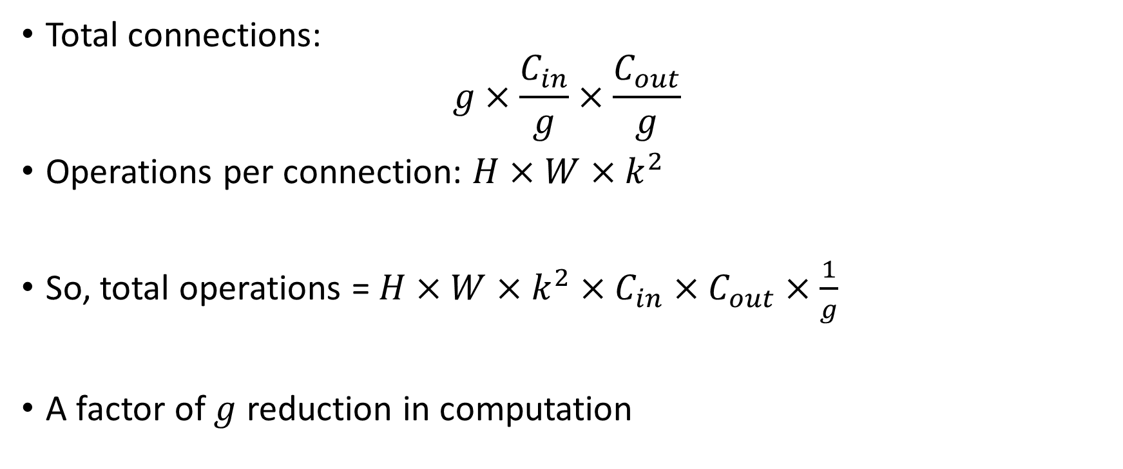
Grouped Convolution
Total connections:
$$g×\frac{C_{in}}{g}×\frac{C_{out}}{g}$$
Operations per connection: $H×W×k^{2}$
So, total operations = $H×W×k^{2}×C_{in}×C_{out}×\frac{1}{g}$
A factor of $g$ reduction in computation

Slide 55
Depthwise Separable Convolution
Key to achieving extremely memory and compute efficient CNN models, e.g., MobileNets
Each Convolution Layer composed of two operations
Depthwise Convolution
Pointwise Convolution

Slide 56







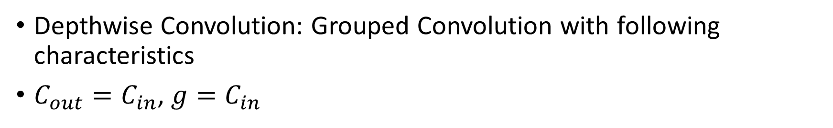









Depthwise Separable Convolution
Depthwise Convolution: Grouped Convolution with following characteristics
$C_{out}=C_{in}$, $g=C_{in}$
$$0$$
$$1$$
$$2$$
$$3$$
$$g=C_{in}$$
$$C_{in}$$
$$0$$
$$1$$
$$2$$
$$3$$
$$C_{out}$$
$$0$$
$$1$$
$$2$$
$$3$$
Note: Each cell here is an entire $k×k$ kernel

Slide 57
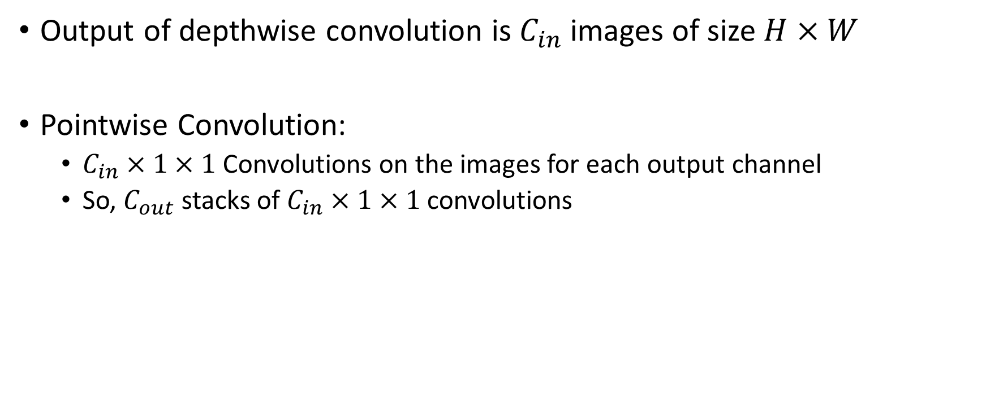
Depthwise Separable Convolution
Output of depthwise convolution is $C_{in}$ images of size $H×W$
Pointwise Convolution:
$C_{in}×1×1$ Convolutions on the images for each output channel
So, $C_{out}$ stacks of $C_{in}×1×1$ convolutions

Slide 58






Depthwise Separable Convolutions
Depthwise Convolution
Note: No pixel wise addition
$$H$$
$$W$$
$$C_{in}$$
$$H$$
$$C_{in}$$
$$W$$

Slide 59






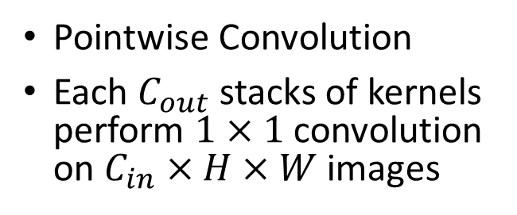


Depthwise Separable Convolutions
Pointwise Convolution
Each $C_{out}$ stacks of kernels perform $1×1$ convolution on $C_{in}×H×W$ images
$$C_{in}$$
$$H$$
$$C_{in}$$
$$W$$
$$C_{in}$$
$$C_{out}$$
$$1×1$$
$$C_{in}$$

Slide 60
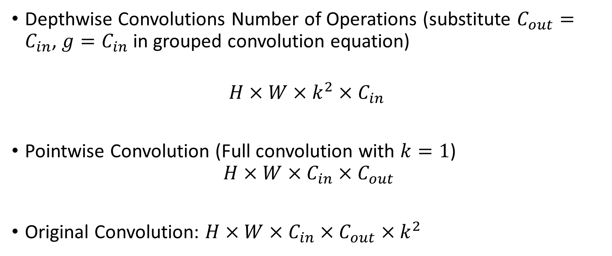
Depthwise Separable Convolutions
Depthwise Convolutions Number of Operations (substitute $C_{out}=C_{in}$, $g=C_{in}$ in grouped convolution equation)
$$H×W×k^{2}×C_{in}$$
Pointwise Convolution (Full convolution with $k=1$)
$$H×W×C_{in}×C_{out}$$
Original Convolution: $H×W×C_{in}×C_{out}×k^{2}$

Slide 61
Maintaining Accuracy
Train or re-train models with sparsity constraints
This ensures model is trained properly using reduced number of weights

Slide 62
Advanced Group Convolution Algorithms
ShuffleNets – Group Convolution followed by shuffling of connections
CondenseNets – Connections between channels part of training
Optimal scheduling of groups on GPUs
Pytorch scheduling is vary naïve – may lead to sub-optimal GPU resource utilization for models such as CondenseNets
My PhD student has a knapsack+ILP based algorithm for optimal scheduling – if you are interested, I can share the paper with you

Slide 63
Quantization
Reduce the size of data type used to represent weights of the kernels
Instead of using 64 bit floating point, use 16 bits or 8 bits
Model size reduced by 4 to 8 times
Number of operations remain the same, but current GPUs have the capabilities to process them 4 to 8 times faster
We will look at one such technique in Transformer Acceleration

Slide 64
Next Class
10/2 Lecture 12
GPU Programming using AMD HIP

Slide 65
Thank You
Questions?
Email: sanmukh.kuppannagari@case.edu

